Slide 1

Building better APIs

Slide 2
Everybody’s talking with apis
The number of APIs in every day applications is increasing
In my current apps we couple together half a dozen APIs from Sendgrid to Twilio to a bunch of APIs dealing with cars
We communicate with different groups inside the same company using APIs
Every one of them is terrible in its own special way

Slide 3
A cornucopia of design choices
Remote method invocation (Web Methods, CORBA, etc.)
Event Driven
REST
GraphQL
Notes:
There are a number of techniques you can use to build out APIs. Some of them are better for internal systems, and some for external system. Way back in the day we use to use remote method invocation….

Slide 4
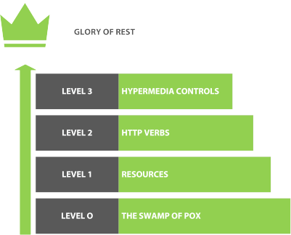
Rest Maturity
The Richardson Maturity Model describes 4 levels of building RESTful apis
Each level is harder to achieve
Notes:
Talk about each level

Slide 5

Building great APIs

Slide 6
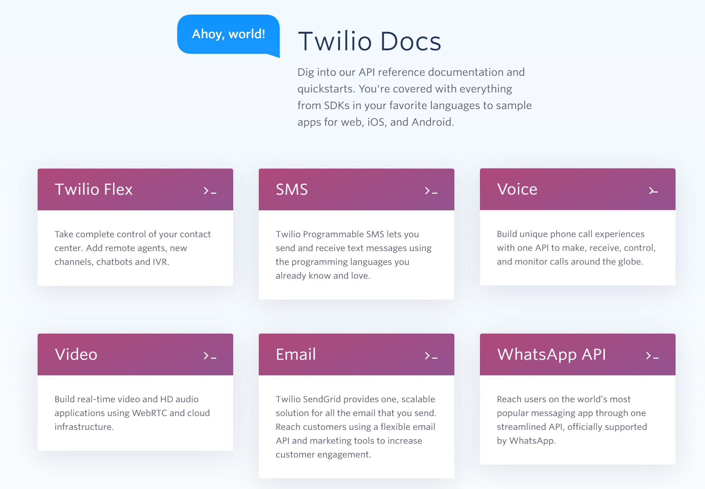
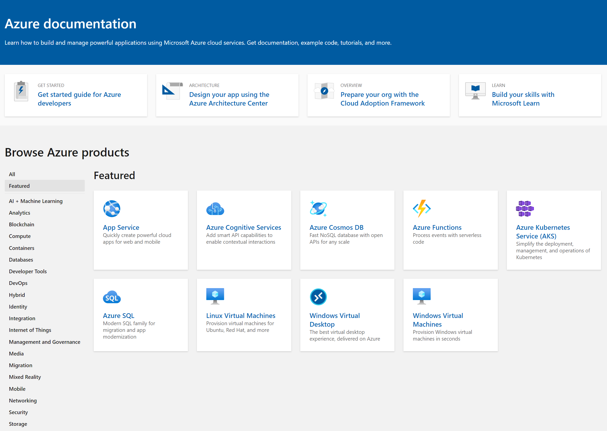
Start with amazing documentation
Notes:
If we want people to use our APIs and we do want that then the place to start is with good documentation. When I started programming Java was hot stuff and the docs for it were really good, considering it was 2000 and most people were still crawling out of the primordial ooze.

Slide 7
Swagger/open api
Notes:
The leading industry standard is a specification called open api. It was called swagger which I felt was a way better name. open api is a way of documenting your apis in a way that can be used both by humans and by computers.

Slide 8
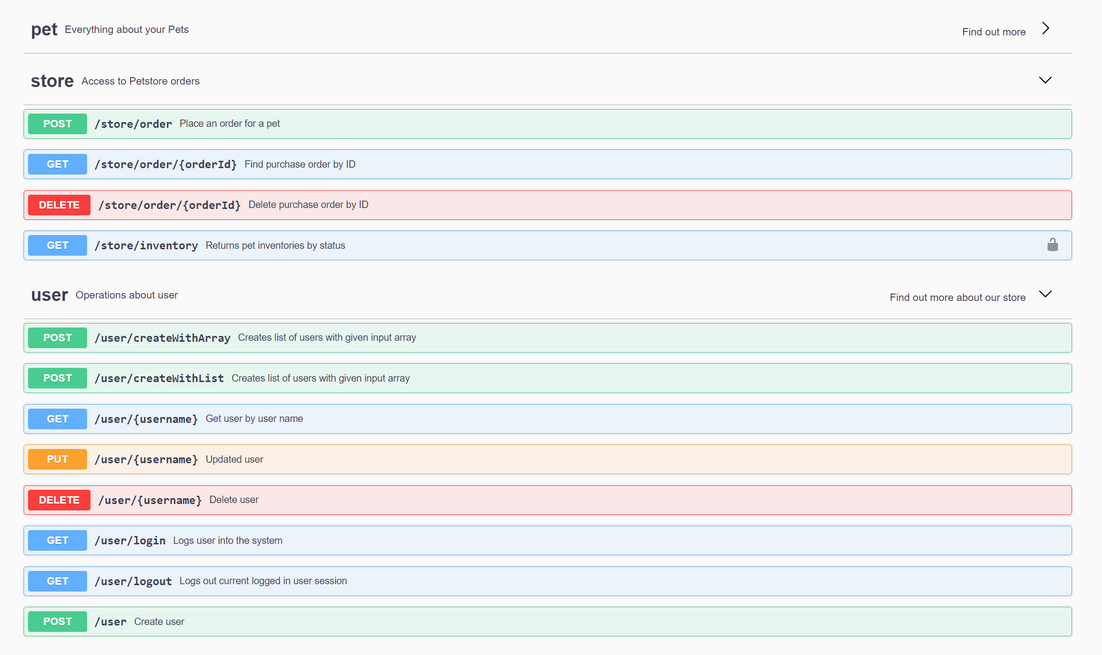
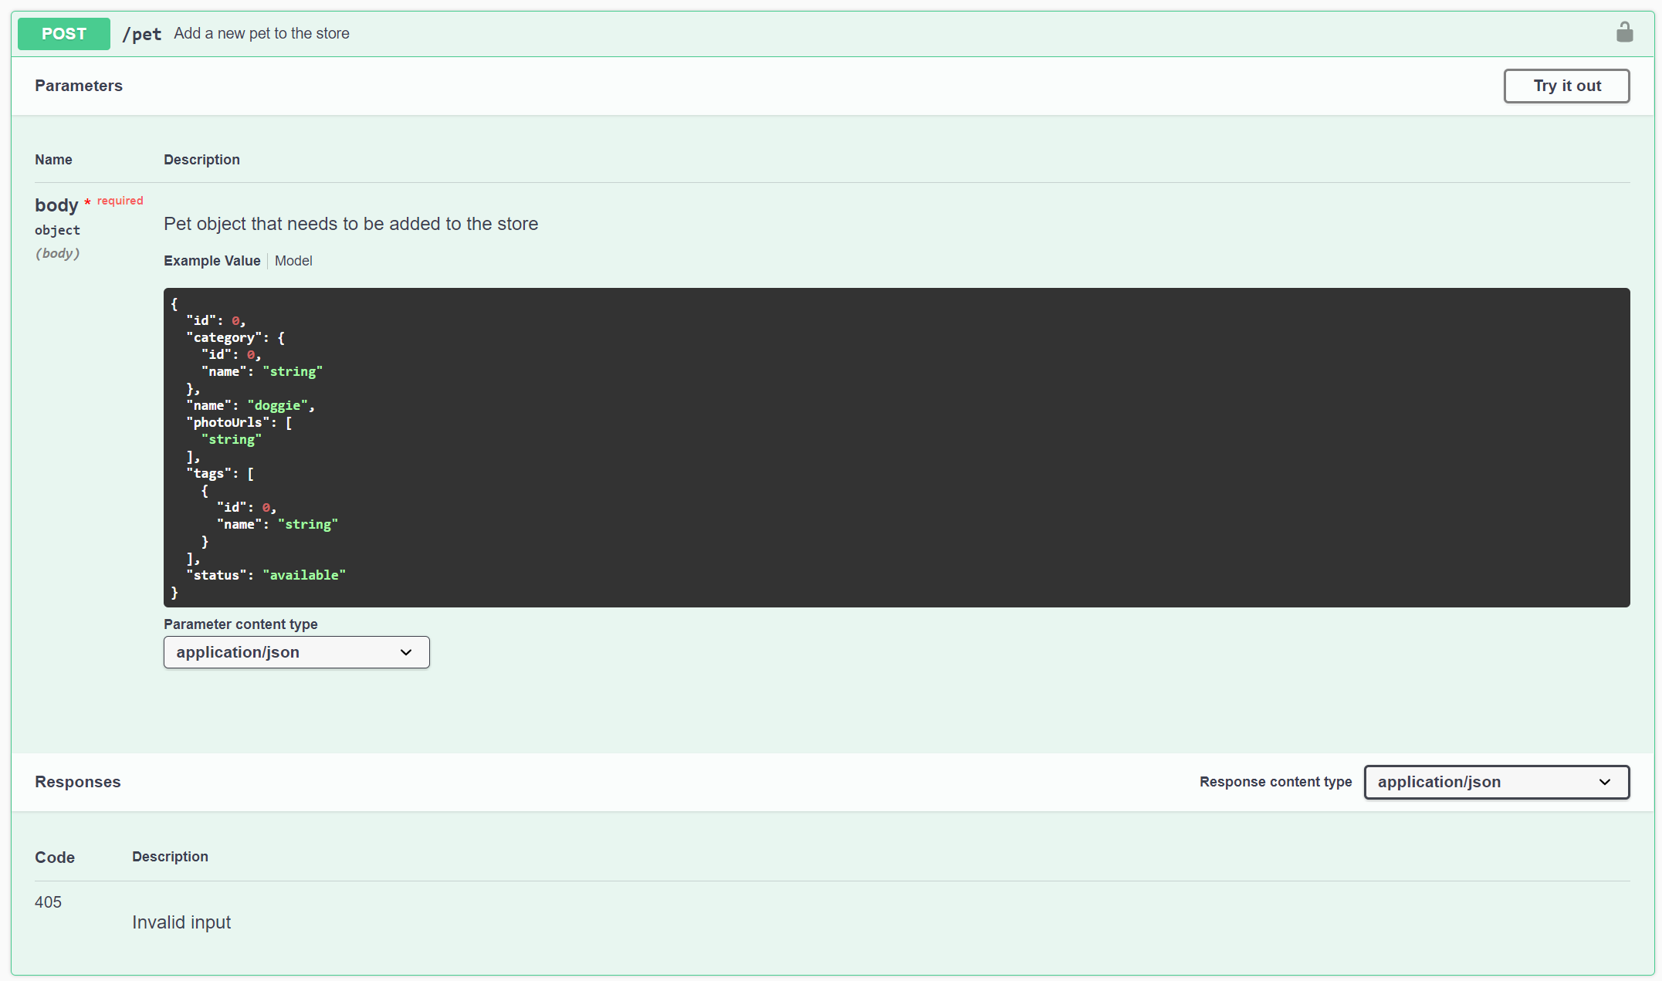
Swagger ui
Notes:
The swagger UI reads open api files and displays a handy visualization of each resource and the operations that you can perform on them

Slide 9
Swagger ui
Notes:
Drilling into one method we can see a sample body, the responses and parameters. You can even click on the try it out button to execute the api

Slide 10
Asp.net core has swagger
Demo
Notes:
Drop to visual studio and demo swagger

